Slide 1
Development and characterization of silicon carbide based composites
Under the guidance of : Dr. B V Manoj Kumar
Submitted By:
Seth Riddheish Anilkumar - 13118080
Ravi Shankar Yadav - 13118072

Slide 2
Introduction to the Problem Statement:
Previous analysis on sintering of monolithic SiC showed that densification of about 98% took place at a temperature of 1950ºC,via Conventional Hot Pressing Sintering.
Problem: Grain coarsening which in turn leads to decline in mechanical properties.
The study aims to increase mechanical properties at elevated temperature. Spark plasma sintering has also been carried out to achieve greater densification but the problem of grain coarsening persists in it.
One of the major drawbacks in this approach was - greater densification was obtained but at such a high temperature considerable grain coarsening took place. These larger grains led to a fall in the mechanical properties of the developed ceramic.
THE SOLUTION :
To overcome this large number of additives have been tried. Each of them have been tried so that it could lower the sintering temperature by providing a liquid phase in the medium. Enhancement in densification was observed along with an improvement in mechanical properties.
Additives improved densification by:
a) Formation of a liquid phase to fill the pores,
b) quick necking between two particles.

Slide 3
Analysis of Solution:
TiCN (Titanium Carbonitride) is being used in SiC composite. This composite was fabricated using β-SiC and TiCN powder. Aim : Sintering should lead to >=96% densification at lower temperature and pressure than before.
We aim to study phase composition and evolution throughout the experimental procedure.
TiCN has some excellent properties such as thermal conductivity, toughness and wear resistance. Thus when combined with SiC it can really form a composite which can have application in areas where both electrical, thermal and mechanical properties are required together.
One of the major problems above was that the sintering was carried out by conventional methods. These have certain drawbacks:
1) Slow heating and cooling rate resulting in grain coarsening.
2) Binder was mixed which resulted in a reduction of mechanical properties.
3) Sintering time was more than Spark Plasma process.
Thus to overcome these drawbacks, sintering of SiC composite will be carried out by Spark Plasma Sintering process, owing to its fast sintering time and many other advantages. In this process the sintering temperature was 1800ºC and for very short sintering time i.e. 5 mins.

Slide 4
Why TiCN as a reinforcement ?
We considered multiple compounds as additives, based on a)properties b)availability c)previous research into their behaviour
TiC and TiCN as additives were considered.
TiCN chosen because:
1) Compared with TiC-based ceramics, TiCN-based ceramics have much higher high-temperature hardness, higher transverse rupture toughness, better resistance to oxidation, and much higher thermal conductivity.
2) Due to the much finer grains of the hard phase in TiCN-based ceramics, the resistance to high-temperature creep deformation of TiCN-based cermets is much better than that of TiC-based ceramics.
3)Harder to form oxide layers during sintering process as enthalpy of formation for TiCN is significantly more.
Reference:Ying Peng , Hezhuo Miao , Zhijian Peng,Int. Journal of Refractory Metals and Hard Materials 39 (2013) 78–89

Slide 5
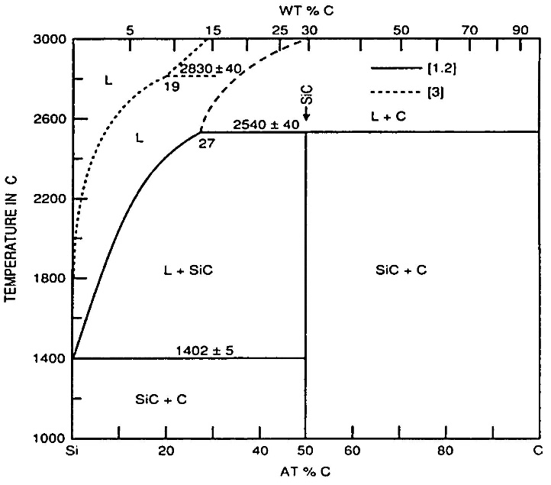
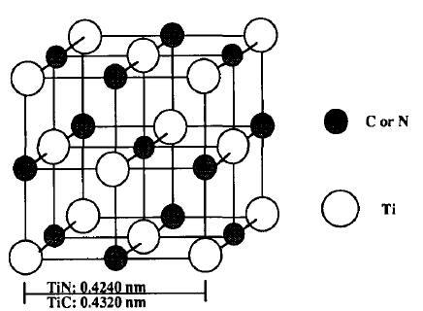
Crystal Structure Analysis of SiC and TiCN
Silicon carbides polytypes are 3C, 4H and 6H.
β-SiC→Cubic 3C→Zinc blend
α-SiC(6H) →wurtzite
Eutectic point between silicon and SiC exists at 1402˚C and 0.75 atom % C.
Phase transformation of SiC occurs from β-SiC to α-SiC upon heating. Undoped β-SiC transforms to 6H α- SiC above 2000°C.
TiCN :
Titanium carbide (TIC) and titanium nitride (TIN) are the basis for titanium carbonitride.
TiC and TiN have a sodium chloride structure.
Notes:
15R-ABCACBCABACABCB

Slide 6
Work Plan
Sample Preparation
SiC and TiCN Primary calculation
Milling of SiC in planetary ball mill
Composite Characterization
Spark Plasma Sintering
Sintering of each composition
Density Evaluation
And Material testing
Mixing of SiC And TiCN in planetary ball mill
SEM, XRD and EDS for all composites.
Density evaluation of all samples
Mechanical Tests(Hardness,

Slide 7
Milling of pure SiC and Mixing with TiCN
Dimension of pellets formed/to be formed is diameter=10mm,thickness=4mm.
Total weight of SiC - 14 gm and TiCN - 8 gm with assumption powder loss 20% by weight in various losses. Samples- (By Volume Percent)
Pure SiC(1.2106g)
SiC-W + 10% TiCN (SiC-1.089g,TiCN-0.191g)
SiC-W + 35% TiCN (SiC-0.7868g,TiCN-0.6705g)
SiC-W + 50% TiCN (SiC-0.6053g,TiCN-0.9579g)
Reasoning behind choice of Toluene as solvent:
Toluene does NOT have presence of OH- group.
This significantly reduces its oxidising nature as well as polarity (due to presence of C-O bond).This is not the case with other choices such as ethanol or acetone.
Contamination of Tungten via milling balls and jar need to be accounted for and if possible,prevented. Prevention not possible, so we take this to be an SiC-W + TiCN composite and account for properties accordingly.
Parameter | Pure SiC | SiC-W with 10%, 35%, 50% TiCN
Time | 63 hours | 12 hours
Speed | 200 rpm | 125 rpm
Tungsten balls | 33 | 8
Ball-powder ratio | 10 | 10
Solvent | Toluene | Toluene

Slide 8
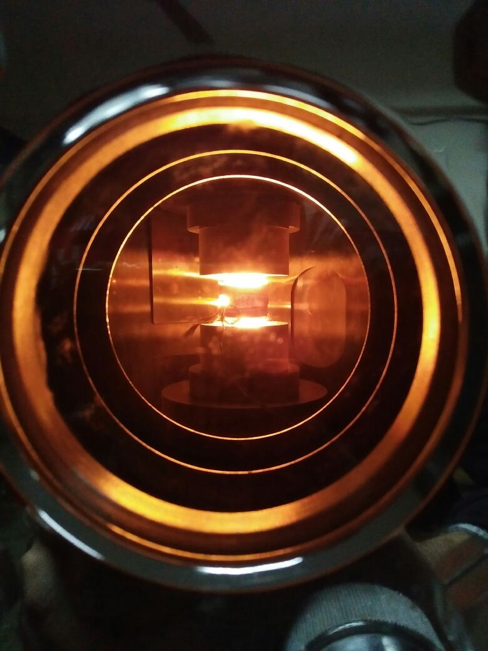
Spark Plasma Sintering
Parameter | Pure SiC | 90% SiC with 10% TiCN | 65% SiC with 35% TiCN | 50% SiC with 50% TiCN
Total Time | 58 min | 58 min | 58 min | 58 min
Holding time | 5 min | 5 min | 5 min | 5 min
Voltage | 5 V | 5 V | 5 V | 5 V
Heating rate | 100 °C/min | 100 °C/min | 100 °C/min | 100 °C/min
Sintering temp. | 1800 °C | 1800 °C | 1800 °C | 1800 °C
Cooling time | 38 min | 38 min | 38 min | 38 min
Load on Die | 3.6 kN | 3.6 kN | 3.6 kN | 3.6 kN

Slide 9
SPS plots for Pure SiC and SiC +10% TiCN :
Comparative plot leads to one observation regarding major difference between Current vs Time(x-axis): Current magnitude at holding time is significantly lower for pure SiC vs SiC with 10% TiCN. This is due to superior conductivity as Ti+ ions present at point of reaction lead to enhanced conductivity.

Slide 10
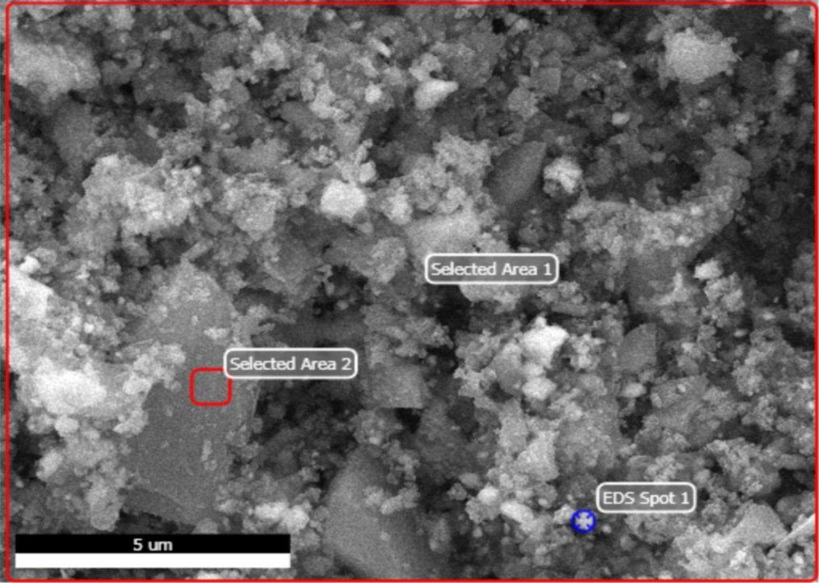
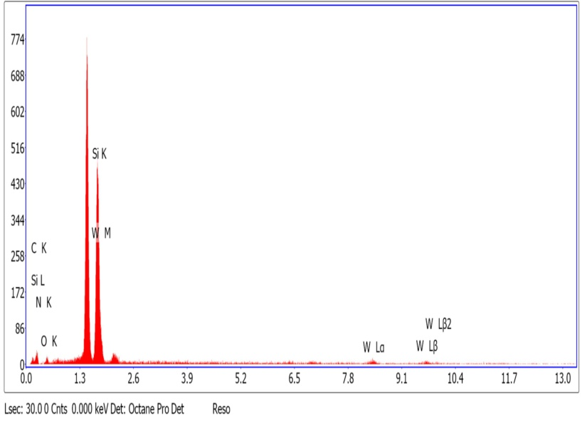
EDS :SiC-W
EDS DATA- Pure SiC-whole sample(Selected Area 1)
Element | Weight% | Atomic% | Net int. | Error %
C K-line | 37.09 | 68.08 | 8.27 | 17.87
N K-line | 0.29 | 0.77 | 0.06 | 99.99
O K-line | 7.22 | 9.95 | 3.20 | 33.27
Si K-line | 32.14 | 17.22 | 81.21 | 4.65
W L-line | 23.26 | 3.99 | 7.59 | 41.33
From this we can comment on the phases in this sample:
1)Light and dark colouration implies presence of different phases in the sample. Major phase-SiC, minor phases-SiO2 and other compounds.
2)Major elements present-C,Si,W
3)Tungsten an impurity , added at milling stage

Slide 11
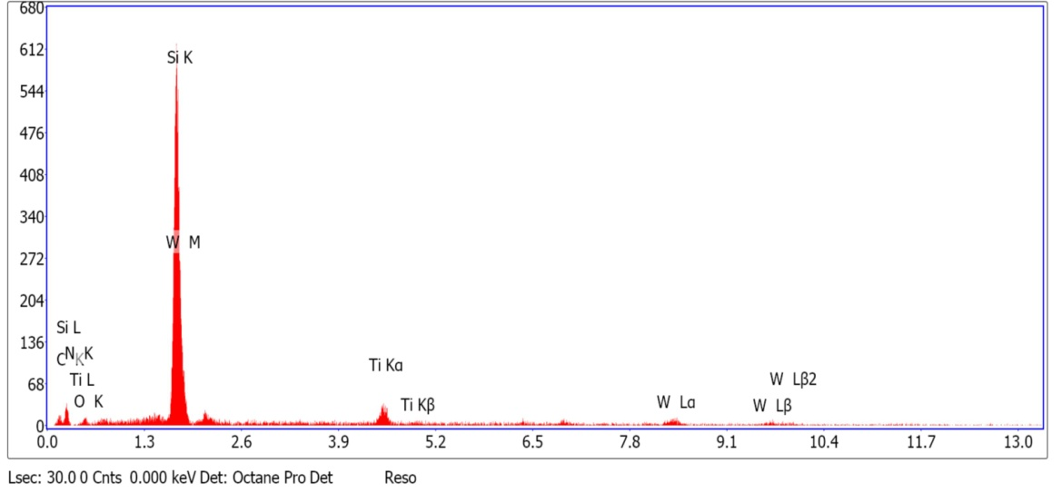
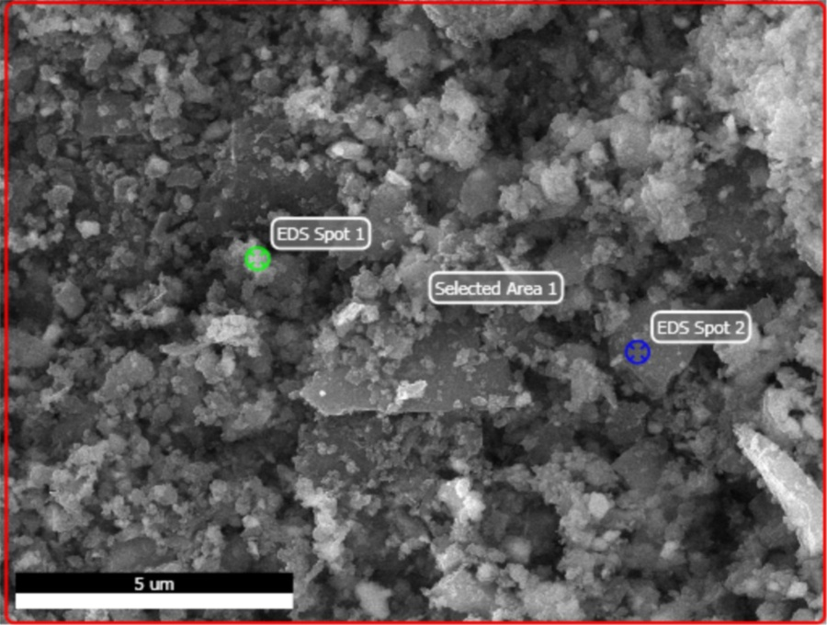
EDS:SiC-W with 10% TiCN
EDS DATA- SiC with 10% TiCN
Element | Weight% | Atomic% | Net int. | Error %
C K-line | 29.32 | 58.03 | 9.17 | 17.08
N K-line | 0.14 | 0.24 | 0.03 | 99.99
O K-line | 3.57 | 5.31 | 2.60 | 27.98
Si K-line | 35.06 | 29.67 | 237.95 | 4.07
Ti K-line | 9.15 | 3.55 | 21.14 | 15.21
W L-line | 22.77 | 3.20 | 10.12 | 30.31
From this we can comment on the phases in this sample:
1)Major elements present-C,Si,W
2) This sample set also showed many phases, but almost all were as expected, with TiC and TiCN both formed. TiCN showing non-stoichiometric ratio of C=0.7 and N=0.3. We believe it is due to larger amount of present C during SPS stage, where Ti+ ions have greater pulling power over C atoms due to ionic behavior and stronger Ti-C bond vs Si-C bond.
SiC existed in two forms, rhombohedral and 6H as from batch 1 pure SiC. W,C and N compounds existed here too, with density variation expected here as well.

Slide 12
Comparative analysis of SiC-W+35%TiCN and SiC-W+50%TiCN
SiC-W+35%TiCN | SiC-W+50%TiCN
In this Batch had SiC dominantly in 1 phase-hexagonal or 6H, with only traces of others. TiCN was non-stoichiometric too, but reverse of Batch 2.C=0.3,N=0.7 indicating that larger amount of T^{i+} ions had made C as limiting reagent during recombination and made N as larger faction. | 6H SiC only dominant phase evolved, in case of SiC.Other phases of SiC present in negligible amount.
SEM Analysis: Darker region is SiC rich, as is discussed in prior samples, and confirmed by taking spot EDS over darker and lighter regions. Lighter region is W-rich and Ti-rich, with higher % of Ti and W confirmed by peaks obtained in EDS. But there are some portions of sample, completely black, which are indicator of porosity in sample. Images taken are normal etched images. | On conducting SEM analysis we conclude darker portions to be SiC-rich, while lighter portions are rich in Ti compounds, with TiCN present as major source of Ti. Images taken are with normal etchant-KOH 50%/NaOH 50% 1M solution. Completely black regions indicate porosity present in this sample too, and show that 100% densification was not achieved. However, such regions are present in this sample the least, indicating that TiCN % increase helps in getting better densification.
EDS spot analysis: We not only get confirmation of lighter and darker spots' composition in terms of present phases (similar to prior samples, darker phase is SiC rich portion), but peaks' overlap confirms presence of solid solution and shows the trend of WC-SiC solid solution(indicated by study of peaks too-Si overlap with W at ~ 41.6°). | Spot analysis confirms composition of lighter and darker regions, and darker region is SiC rich, while lighter region is TiCN rich.
XRD analysis: We get The peak of SiC at 41.7°, and TiCN at ~50°. | XRD analysis: On doing XRD analysis we got peaks as in previous 2 samples with additives. Here too, we see Si peaks at ~41.6 and TiCN at ~50.

Slide 13
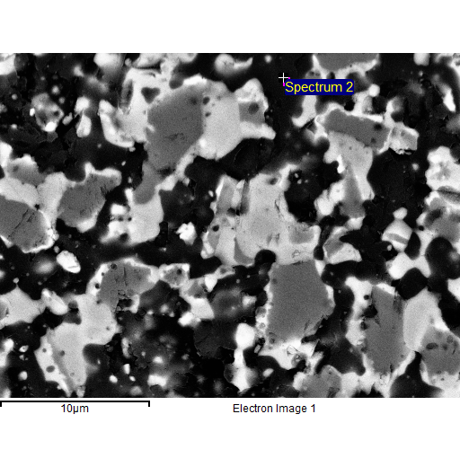
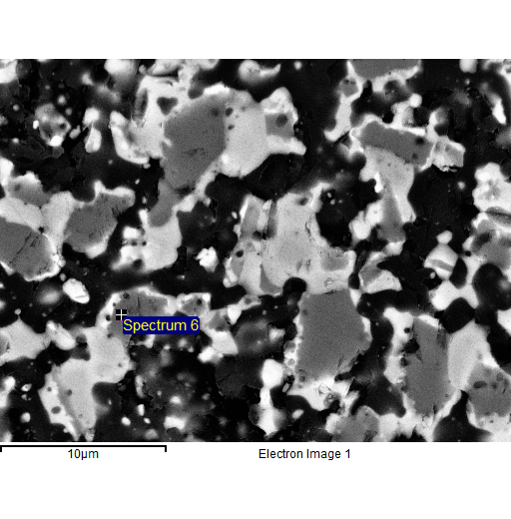
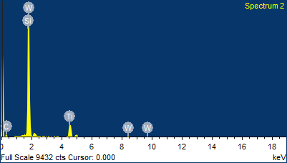
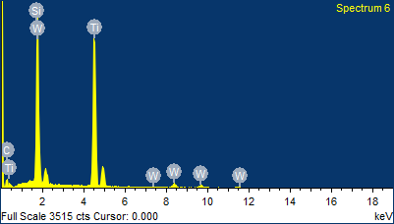
SiC-W+35%TiCN
Element | Weight% | Atomic%
C K | 24.60 | 46.28
Si K | 56.25 | 45.26
Ti K | 17.49 | 8.25
W M | 1.66 | 0.21
Total | 100 | 100
Element | Weight% | Atomic%
C K | 11.38 | 32.56
Si K | 21.8 | 26.67
Ti K | 53.33 | 38.25
W M | 13.49 | 2.52
A darker region of sample marked Spectrum 2.
Spot analysis of this region-darker portion of our sample- gave the above elemental composition.
The dominant peak of Si confirms this to be a SiC rich region(Si present only in SiC compound form).
Overlapping of the peaks of SiC-W indicates that solid solution is formed.Darker region is Si-rich.
This portion of our sample is lighter.
This region is richer in Ti.
We see Ti peak is significantly higher than in graph for Spectrum 2.

Slide 14
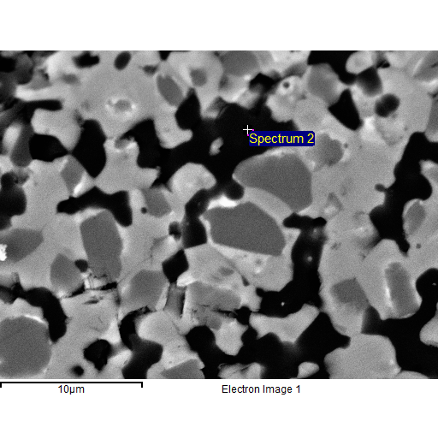
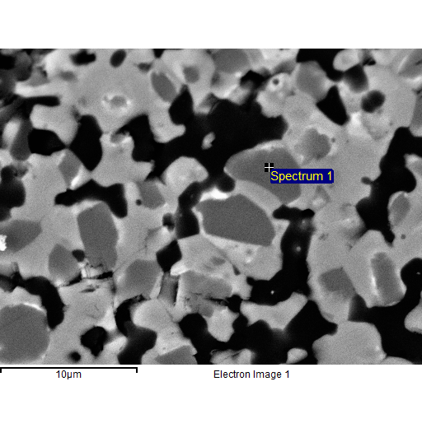
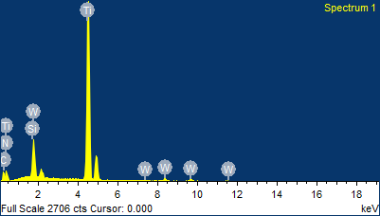
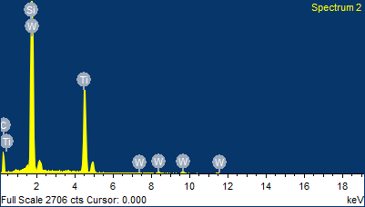
SiC-W+50%TiCN
Element | Weight% | Atomic%
C K | 36.98 | 61.24
Si K | 41.56 | 29.43
Ti K | 21.81 | 9.47
W M | 1.35 | 0.15
Element | Weight% | Atomic%
C K | 8.98 | 26.09
N K | 6.09 | 15.17
Si K | 3.96 | 4.92
Ti K | 71.37 | 52
W M | 9.6 | 1.82
Spectrum 2 Spot analysis: This is a darker region of sample.
SiC % higher in this region than in a lighter portion of the sample.
Lighter region, as stated from SEM analysis, shows large % of Ti when compared to darker regions surrounding it.
Ti peak is markedly higher than in spectrum 2(in fact highest of all elements here)this EDS graph,showing it to be Ti rich region

Slide 15
Density Evaluation:SiC/W and table of density evaluation:
Weight of sample in air=0.8615
Weight of sample in water = 0.654
Dimensions : Diameter=10mm, Thickness=4 mm
Volume=314.159 cc
Density(experimental)= 4.167 g/cc
Expected density=3.21 g/cc
Necessary precautions taken. Measurement errors avoided.
Reasons for difference:Suspected presence of impurities like WO2, SiO2.EDS data confirms this , and implies that expected theoretical density should also account for this. Therefore, we are calculating expected density after including presence of impurities using XRD data.
Inferences from table:
Density of SiC is less than that of TiCN or Tungsten, so density obtained on adding TiCN in larger % is expected to be more and this is what was seen.
Densification %age is not expected to be 100% but closer to 100% is desirable.
We noted that as % TiCN increased, % densification increased too.
This proves that TiCN is a very favourable additive for SPS in case of TiCN.
Sr No | %SiC-W | % TiCN | Theoretical Density | Density obtained | % densification
1 | 100 | 0 | 4.33 | 4.21 | 97.2
2 | 90 | 10 | 4.37 | 4.26 | 97.5
3 | 65 | 35 | 4.71 | 4.64 | 98.4
4 | 50 | 50 | 4.79 | 4.74 | 98.9

Slide 16
Results from mechanical testing
Sample | Contact Depth in nm | Modulus of elasticity in GPa | Hardness in GPa | Mean/Std. Deviation
SiC monolithic | 81.53 | 326.79 | 22.21 | Mean
 | 13.05 | 37.85 | 5.71 | Std Deviation
SiC-W + 10% TiCN | 56.58 | 368.3 | 41 | Mean
 | 4 | 49.32 | 5.39 | Std Deviation
SiC-W + 35% TiCN | 63.32 | 330.47 | 33.67 | Mean
 | 13.31 | 41.32 | 9.01 | Std Deviation
SiC-W + 50% TiCN | 55.26 | 386.87 | 42.65 | Mean
 | 3.64 | 14.5 | 5.04 | Std Deviation
Testing conditions:
Diamond – Berkovich Tip- 3 face Pyramid with Tip Radius 100 nm.
Normal Load Applied- 5000µN
Loading cycle
Constant loading and unloading rate of 62.5µN/ s,93.75 µN/s, 125µN/s
Dwell at a peak load- 2s.

Slide 17
Interpreting Results
1) Density variation occurs with % increase in TiCN, when compared to expected theoretical values computed from principle of mixtures. When comparing across varied sample % ages, we notice that as relative density increases,increased presence of 6-H phase is also seen, indicating it to be a cause. Also, improvement seen in mechanical properties with this presence.
2) Presence of 6-H phases has direct relationship with % TiCN as additive-more the TiCN,more the conversion from β-SiC to 6-H α-SiC.
3) β-SiC to α-SiC transformation indicated to occur during densification process. The change is partial, with large % of cubic β-SiC unchanged. Presence of semi-solid phase inferred from here as there is partial β-to-α transition.
4) α-SiC is present in larger %age as we move from monolithic SiC to samples with increasing %age of TiCN. This in turn makes structure more hexagonal. Also, beyond a threshold, for 35% and 50% TiCN samples, the SiC forms a solid solution with W that got added in during milling stage.
5) Microstructure has lesser porosity present as TiCN increases. This indicates that TiCN is a very effective additive for SPS of SiC based composites, provided we want α-SiC to be the dominant SiC phase.
6) Adding TiCN as additive bettered the hardness of post-sintered composite.

Slide 18
REFERENCES
[1]. Microstructure and mechanical properties of hot-pressed SiC-TiC composite. By H.Endo, M. Ueki, H. Kubo.
[2]. Three-step densification of monolithic SiC ceramics by spark plasma apparatus without sintering additives. By Jie Yin, Yin Liu, Yiquan Wu.
[3]. Microstructure and reaction mechanism of SiC ceramic with mullite-zircon as a new liquid-phase sintering additives system. By Dan Li, Xiumin Yao, Jian Chen, Fang Jiang, Yong Yang, zhengren huang, xuejian Liu.
[4]. Microstructure and mechanical properties of TiB2–SiC ceramic composites by Reactive Hot Pressing. By Guolong Zhao, Chuanzhen Huang, Hanlian Liu, Bin Zou, Hongtao Zhu, Jun Wang.
[5].Thermal and Mechanical Properties of SiC–TiC0.5N0.5Composites. By Kun Mo Kim, Seung Hoon Jang, Young-Wook Kim, Won-Seon Seo.
THANK YOU

